Slide 1
IBM University Engagement Project Submission
“Exploring the Power of Agentic AI with IBM Granite and IBM Bob”

Slide 2

Project Tile – Agentic AI Health Symptom Checker
Domain of Project – Healthcare
Student Name | Recent Passport Photo | Email ID | Mobile number [WhatsApp]
GUNATHANGAM R |  | gunathangamr@gmail.com | 9363130530

Slide 3
Problem Statement -
Problem Statement : Agentic AI Health Symptom Checker
The Challenge
People often experience common symptoms but struggle to understand their possible causes, severity, and appropriate care. Health information is scattered across unreliable websites, social media, and conflicting sources. Without personalized, reliable guidance, users may misunderstand symptoms, follow unsafe remedies, delay medical attention, or attempt self-diagnosis.
The Objective
Build an AI-powered Health Symptom Checker that delivers reliable, personalized, and educational health guidance for users. The solution should:
Symptom Analysis – Understand symptoms entered naturally through text and identify relevant health information.
Medical Data RAG Retrieval – Fetch and summarize medical information from trusted sources such as WHO, government health portals, medical journals, and verified symptom databases.
Probable Condition Identification – Provide possible conditions associated with symptoms without claiming a definitive diagnosis.
Risk & Urgency Assessment – Identify warning signs and recommend appropriate levels of care.
Multi-Agent System –
Symptom Analysis Agent (analyzes user symptoms)
Medical Knowledge Agent (retrieves verified medical information)
Risk & Triage Agent (assesses urgency and warning signs)
Health Advisory Agent (provides preventive advice and care recommendations)
Multi-Language Support – Allow users to interact with the system in multiple languages.

Slide 4
Proposed Solution -
Proposed Solution: Agentic AI Health Symptom Checker
The proposed solution is a multi-agent AI-powered Health Symptom Checker built using IBM Bob, IBM watsonx.ai, and IBM Granite Models to provide reliable, real-time health information and care guidance. The system addresses challenges in symptom understanding, medical information retrieval, risk assessment, and preventive healthcare through an intelligent, modular architecture.
At its core, the solution uses a Retrieval-Augmented Generation (RAG) pipeline to fetch relevant medical information from trusted sources such as WHO, government health portals, verified symptom databases, and medical journals. This information is embedded and stored in a vector database, enabling the system to retrieve and summarize relevant medical knowledge using Granite models.
The system consists of four key agents:
Symptom Analysis Agent analyzes and extracts symptoms from natural-language user inputs.
Medical Knowledge Agent retrieves and summarizes relevant medical information using RAG.
Risk & Triage Agent evaluates symptoms, identifies warning signs, and determines the appropriate urgency level.
Health Advisory Agent provides preventive suggestions, general care guidance, and recommendations for consulting healthcare professionals.
The solution includes a user-friendly interface where users can enter symptoms and receive possible conditions, urgency information, preventive guidance, and appropriate care recommendations.
IBM Bob is used to orchestrate agent workflows, while watsonx.ai supports model deployment, embeddings, and AI governance. Granite models power reasoning, summarization, and contextual response generation.
Overall, this solution delivers an end-to-end intelligent health assistant that promotes early awareness, reduces misinformation, and encourages appropriate medical care.

Slide 5
Technology Used
IBM Bob platform – For designing and orchestrating multi-agent workflows visually.
IBM Granite model – For natural language understanding, reasoning, summarization, and generating context-aware health responses.
IBM Cloud – It provides the infrastructure to build, deploy, and scale the Health Symptom Checker efficiently. IBM Cloud enables a reliable, secure, and scalable environment for deploying the application.
RAG – RAG retrieves verified medical information first, then generates intelligent answers, making the Health Symptom Checker more trustworthy and effective.
IBM watsonx.ai – For model deployment, embeddings, and AI governance.
Vector Database (FAISS/Chroma) – For RAG-based medical knowledge retrieval.

Slide 6
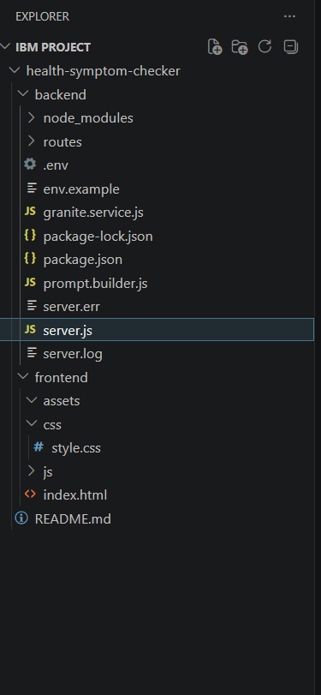
Required Files created using IBM bob -

Slide 7
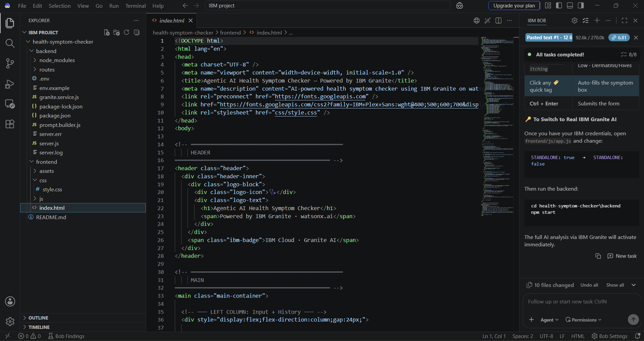
IBM Bob Screenshots:

Slide 8
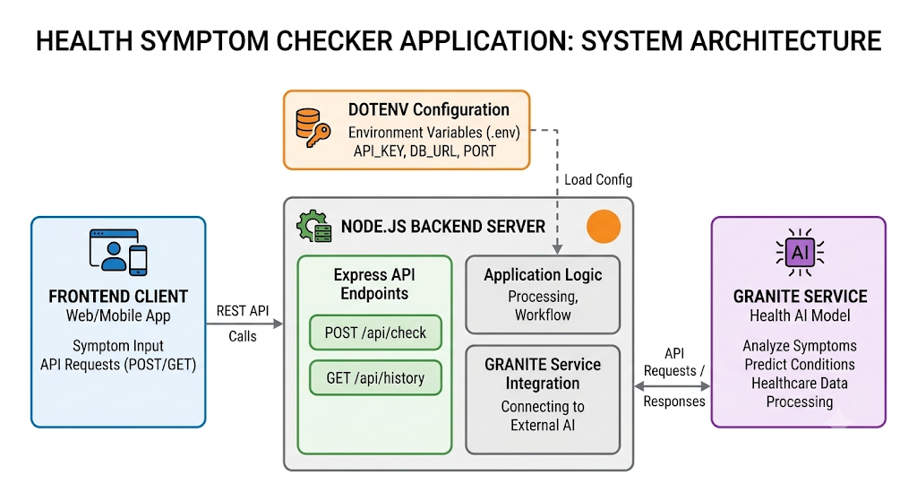
Architecture blueprint for IBM bob:

Slide 9

Role of Agentic AI in the solution
Agentic AI enables the Health Symptom Checker to function as an intelligent, autonomous system rather than a simple chatbot. Using IBM watsonx.ai and IBM Granite models, it coordinates multiple specialized agents to analyze symptoms, retrieve medical information, assess risks, and provide appropriate health guidance.
Each agent performs a specific role—such as analyzing symptoms, retrieving medical knowledge, assessing urgency, and providing health advice—while working collaboratively. This multi-agent approach ensures efficient task execution and context-aware responses.
Agentic AI also brings context awareness, understanding user-provided details such as symptoms, duration, severity, and associated conditions to generate relevant recommendations. It supports real-time adaptation by processing new information provided by the user during interaction.
Additionally, agents communicate with each other, enabling better decision-making and improved outcomes.
Overall, Agentic AI makes the system proactive, context-aware, and goal-driven, acting like an intelligent health information assistant that helps users make informed healthcare decisions.

Slide 10
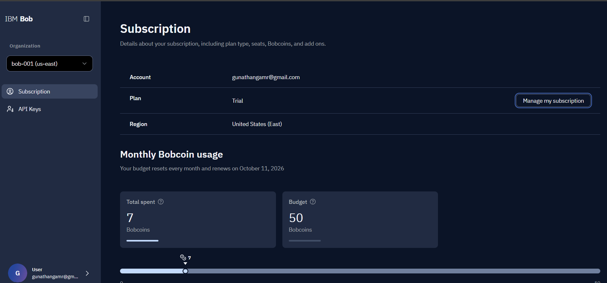
Token Usage
11,761 token are used
·
·
·

Slide 11
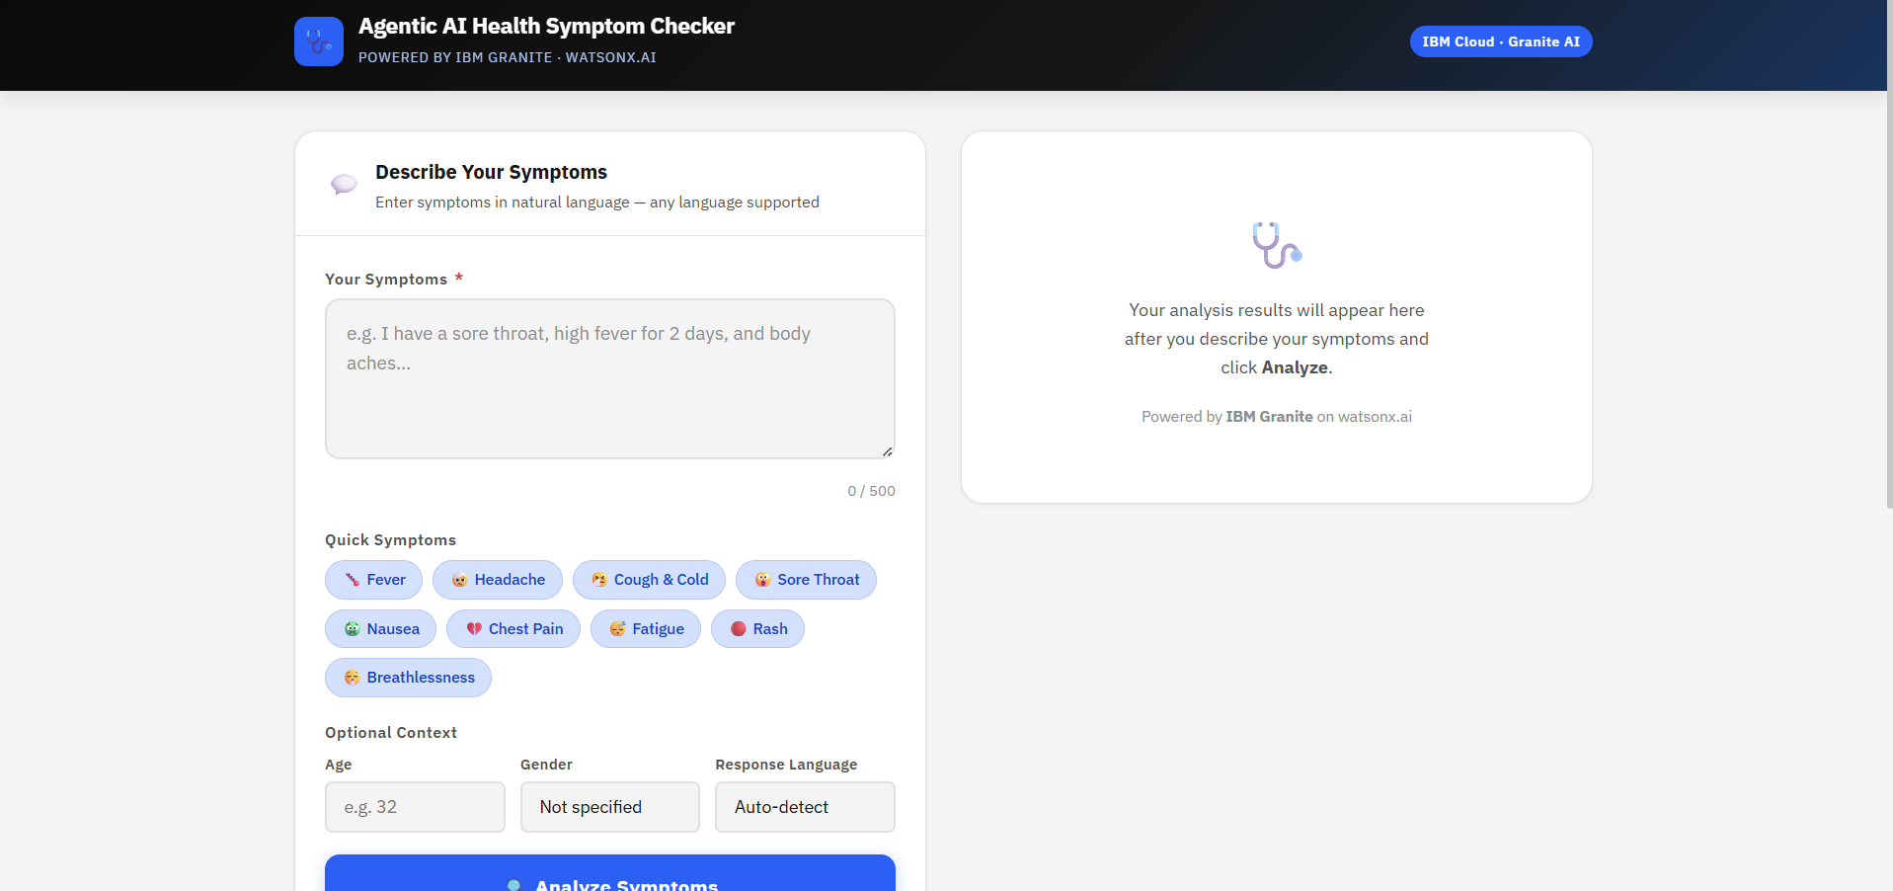
Project Output Screenshot
Please put IBM Bob output screenshots with 2-3 prompts.
You can take 2-3 more slides for each screenshot
·
·
·

Slide 12
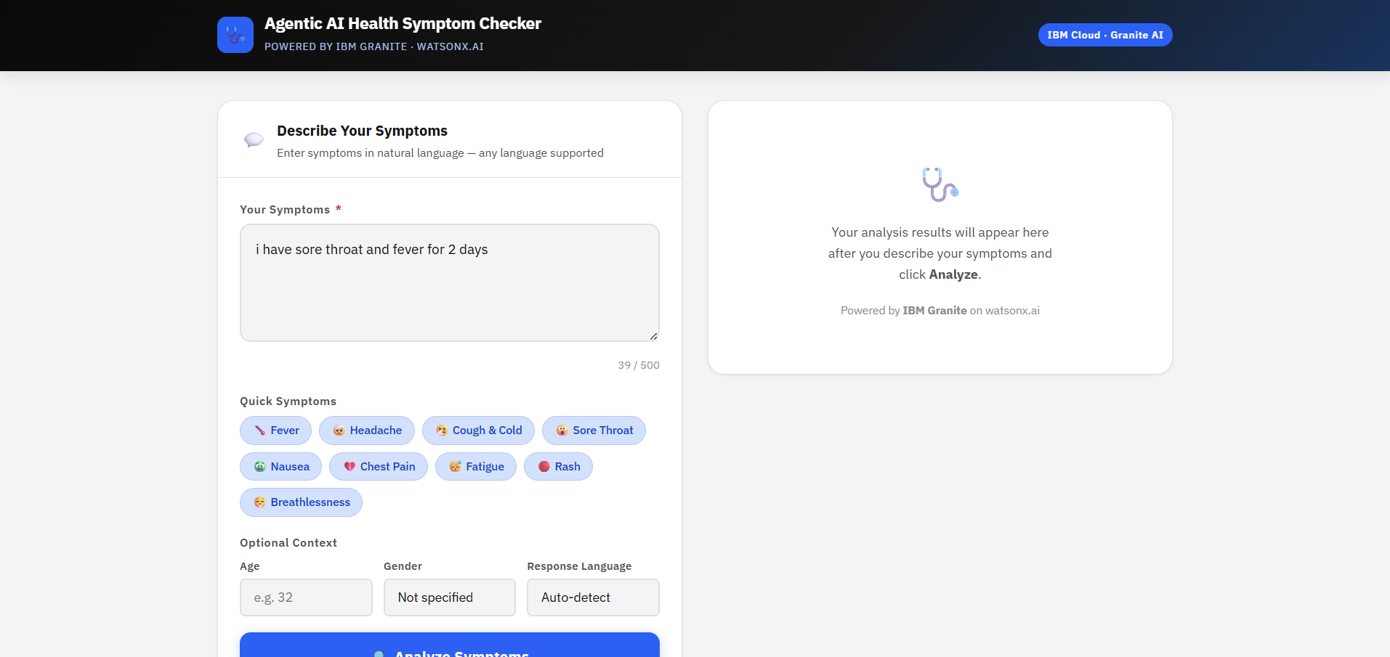
Project Output Screenshot
Please put IBM Bob output screenshots with 2-3 prompts.
You can take 2-3 more slides for each screenshot
·
·
·

Slide 13
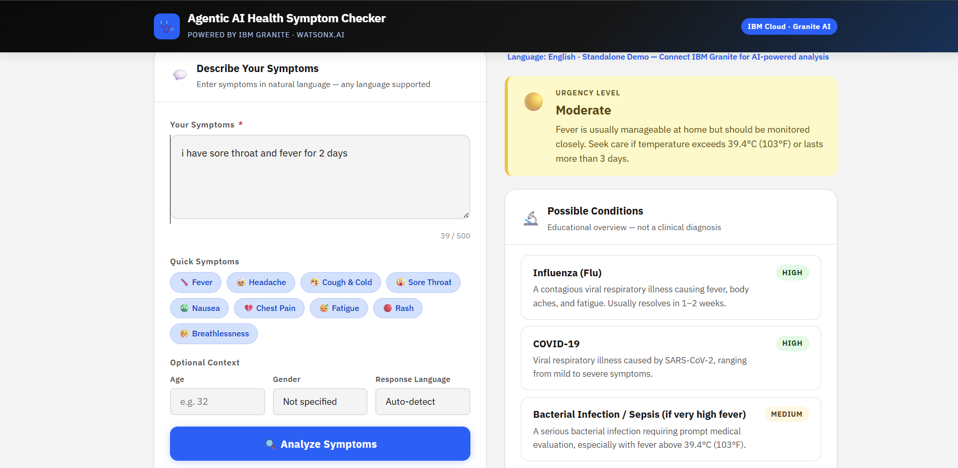
Project Output Screenshot
Please put IBM Bob output screenshots with 2-3 prompts.
You can take 2-3 more slides for each screenshot
·
·
·

Slide 14
Novelty and Uniqueness
The proposed Health Symptom Checker stands out by combining Agentic AI, RAG, medical knowledge retrieval, risk assessment, and personalized guidance into a single intelligent system.
Multi-Agent Intelligence – Instead of a single chatbot, multiple specialized agents collaborate to deliver accurate and context-aware health guidance.
RAG-Based Accuracy – Integrates medical information retrieval with AI generation, reducing misinformation and improving response reliability.
Natural Language Interaction – Allows users to describe symptoms naturally instead of following a fixed symptom-selection process.
Risk-Based Triage – Identifies warning signs and recommends appropriate levels of medical attention.
Safety-Focused Guidance – Provides educational and referral-based suggestions rather than claiming a definitive diagnosis.
Multi-Language Support – Supports multiple languages to improve accessibility and usability.
Scalable & Enterprise-Ready – Built on IBM watsonx.ai with IBM Granite models, ensuring reliable deployment and AI governance.
This makes the solution an intelligent, adaptive, and safety-focused health information assistant, not just a static symptom-search tool.

Slide 15
Git Hub Link
Link: https://github.com/Gunathangam/Health-Symptom-Checker
·
·
·

Slide 16
Future Scope
1. Personalized Health Profile & Longitudinal Health Tracking –
The system can maintain an optional user health profile containing previous symptoms, allergies, medications, existing conditions, and past interactions. By analyzing symptom patterns over time, the agents can identify recurring issues, track changes, and provide more personalized health guidance while keeping the user in control of their data.
2. Multimodal Symptom Assessment –
The system can be extended to accept voice descriptions, medical images, and health-device readings in addition to text. A multimodal agent could analyze inputs such as skin-related images, temperature readings, heart rate, or SpO₂ data and combine them with reported symptoms to provide more comprehensive risk assessment and referral recommendations.
·
·
·

Slide 17
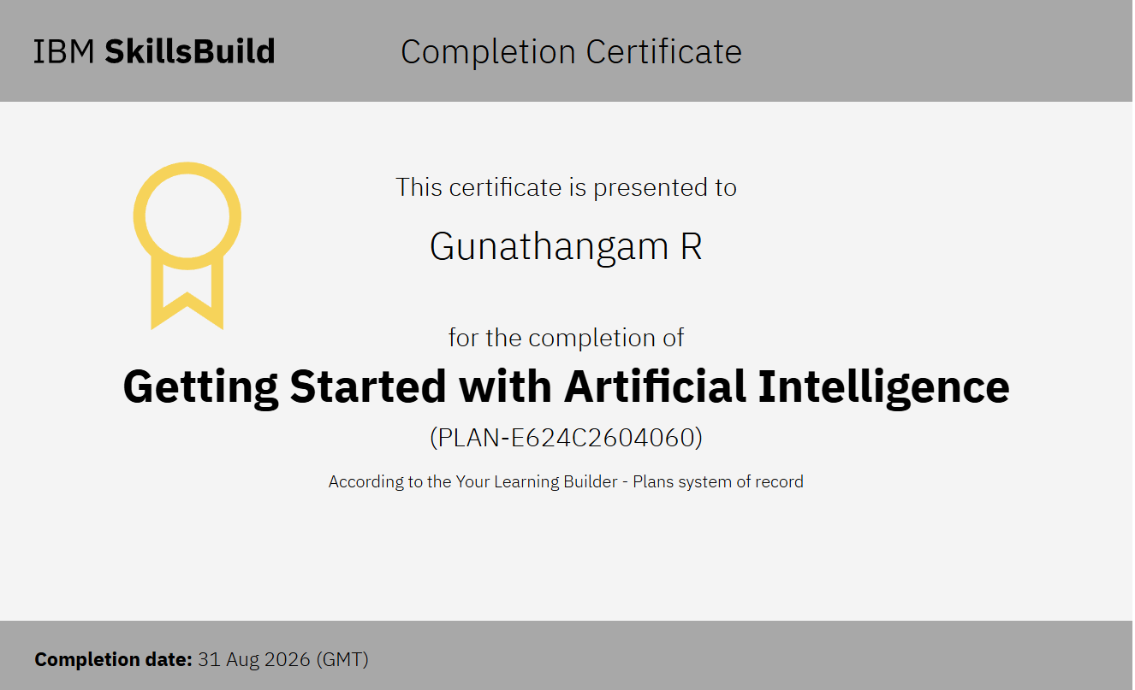
Certificates Earned:

Slide 18
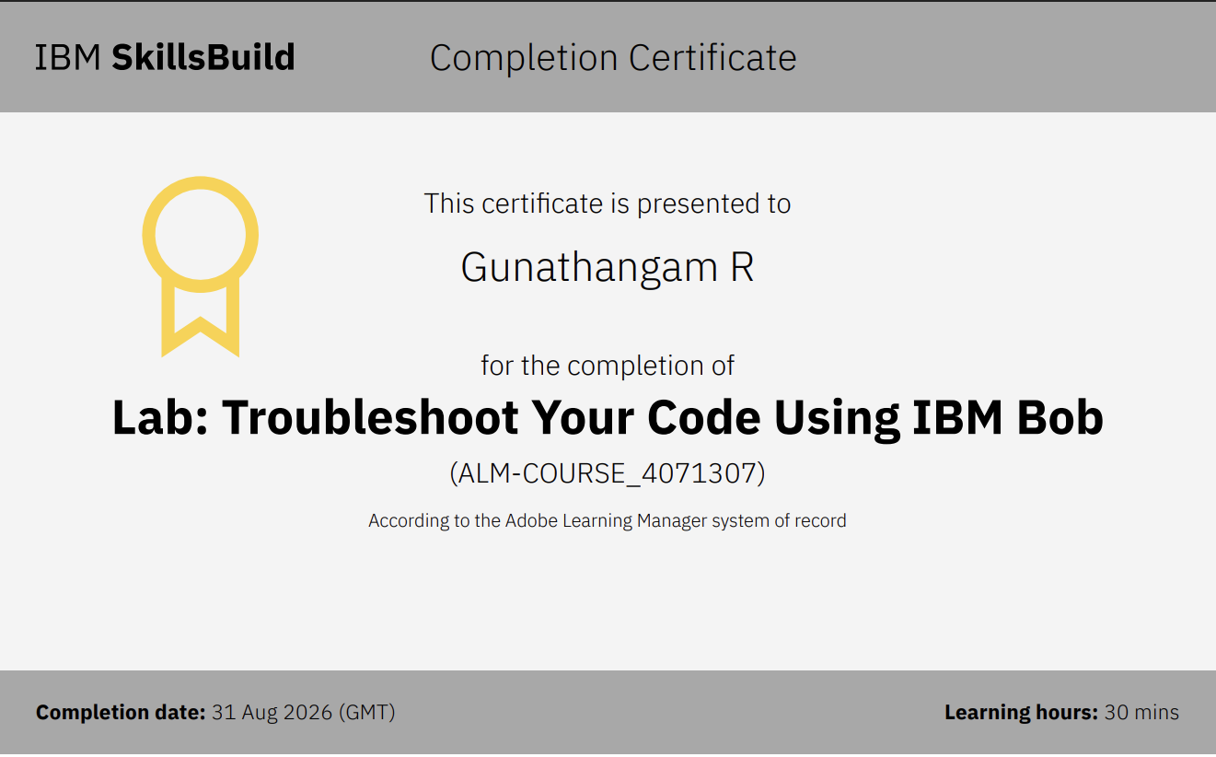
Certificates Earned:​

Slide 19


